Slide 1
Computer Operating System Installation & All Basic Necessary Operations(Windows)
Suzit Biswas
Assistant Hardware Engineer
ICT,BREB
01736180458

Slide 2
What is an Operating System?
An Operating System (OS) is a software that acts as an interface between computer hardware components and the user.
An operating system (OS) is system software that manages computer hardware and software resources and provides common services for computer programs.

Slide 3
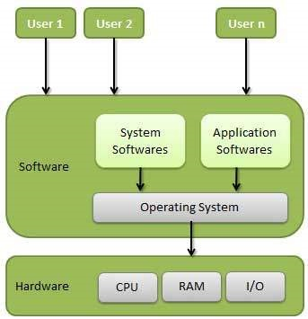
OS

Slide 4
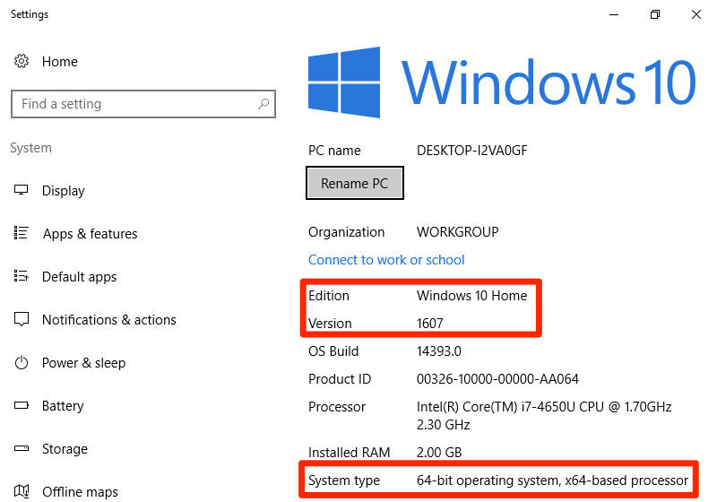
About PC or System Information

Slide 5
Common Boot Keys
Esc,
F2,
F10
or F12,

Slide 6
What is UEFI?
UEFI stands for Unified Extensible Firmware Interface.
It provides a user-friendly Graphical User Interface (GUI). BIOS provides a blue color screen with various options. The normal BIOS cannot recognize large storage drives. UEFI provides a good alternative to this issue and recognizes large storage drives.
In regular BIOS that uses the keyboard to select the options, UEFI allows controlling the interface using the mouse. Moreover, UEFI contains a secure boot. It avoids any digitally unsigned drivers from loading and helps to prevent any malicious software. Some computers with UEFI allows the user to enable legacy BIOS compatibility mode.

Slide 7
What is Legacy Boot
Legacy Boot is the boot process used by BIOS firmware. It stores a list of installed storage devices that are bootable such as Floppy Disk Drives, Hard Disk Drives, Optical Disk Drives, etc. according to a configurable order of priority. When power on the computer, the BIOS performs Power On Self-Test (POST). Then the internal speaker makes a short single beep to indicate that the booting up is normal. The beep code helps to identify the code and to act on further troubleshooting.
After completing POST procedure, the firmware loads the first sector of each of the storage target into memory. Then, it scans it for a valid Master Boot Record (MBR). If a valid MBR is found, the firmware passes execution to the bootloader to select a partition to boot from. If one is not found, it proceeds to the next device in the boot order.

Slide 8
Difference Between UEFI and Legacy Boot
UEFI is a booting process in modern computers that provides advanced capabilities than BIOS. Legacy Boot is the process of booting the computer using the BIOS firmware. This explains the basic difference between UEFI and legacy boot.

Slide 9
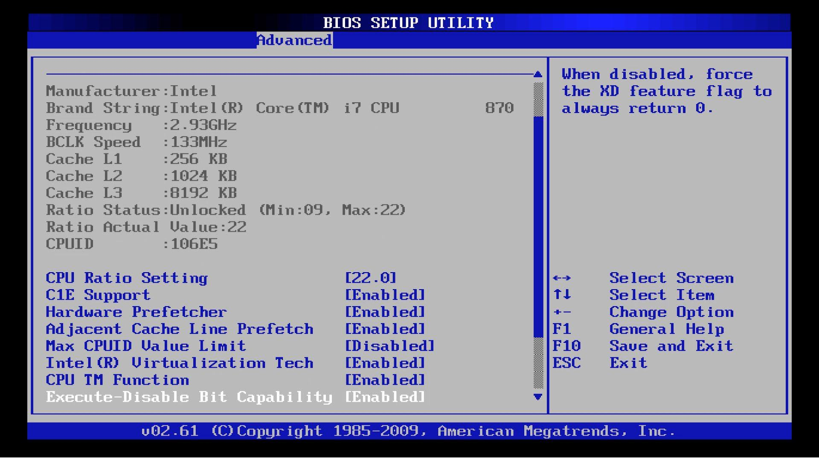
BIOS

Slide 10
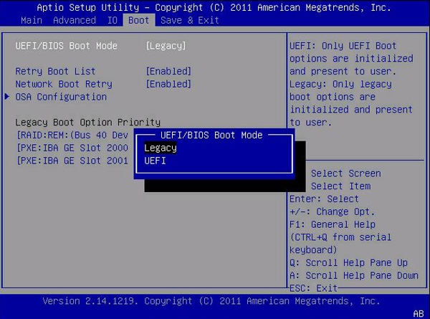
UEFI and Legacy

Slide 11
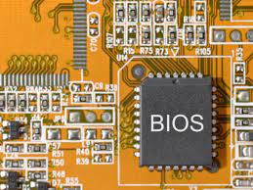
BIOS
In computing, BIOS an acronym for Basic Input/Output System and also known as the System BIOS, ROM BIOS, BIOS ROM or PC BIOS) is firmware used to perform hardware initialization during the booting process (power-on startup), and to provide runtime services for Operating system and programs.

Slide 12
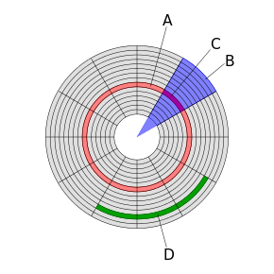
ISO File
An optical disc image (or ISO image, from the ISO 9660 file system used with CD-ROM media) is a disk image that contains everything that would be written to an optical disk, disk sector by disc sector, including the optical disc file system.
Disk structures: Track
Geometrical sector
Disk sector
Cluster

Slide 13
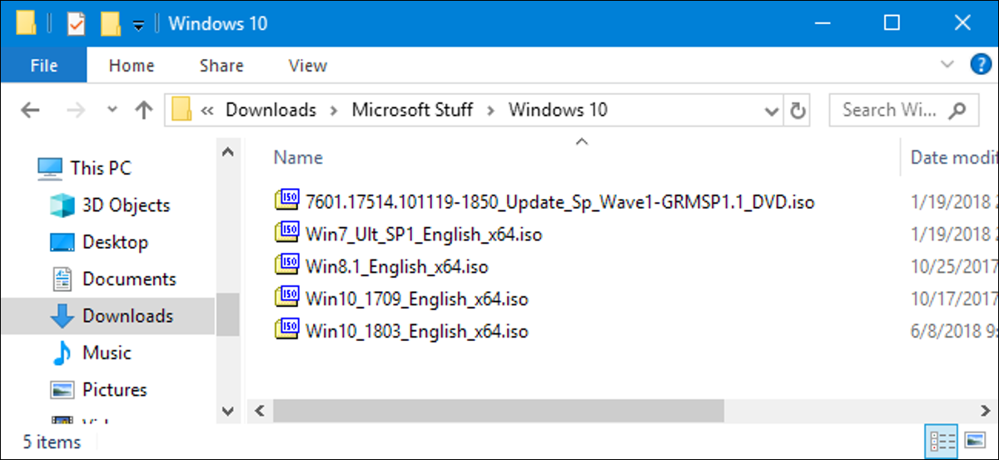
ISO File

Slide 14
Installation of Windows 10 through bootable USB by using Rufus Software.
Rufus is also a small tool which is used to making flash drive bootable. In this method, we need Windows 10 ISO file like the first method which you download from different sources.
After download open the Rufus software

Slide 15
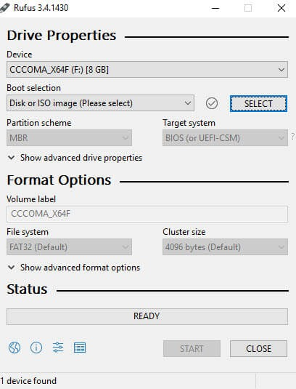

Slide 16
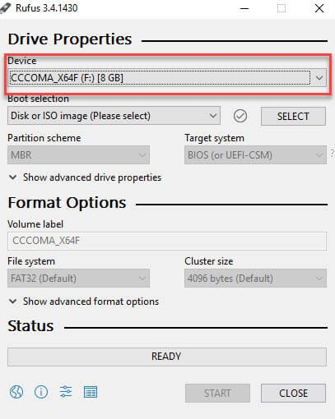
Under Device select your USB drive which you want to use in windows installation and the flash drive should be at least 8 GB.

Slide 17
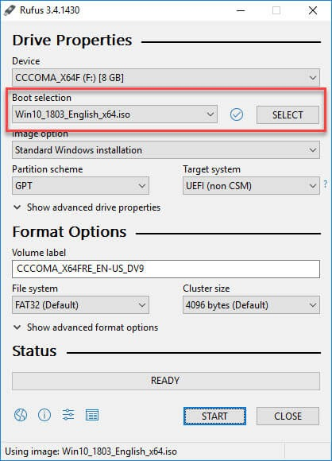
Under the Boot selection, clicks on SELECT Button and browse your Windows 10 ISO file and click on open.

Slide 18
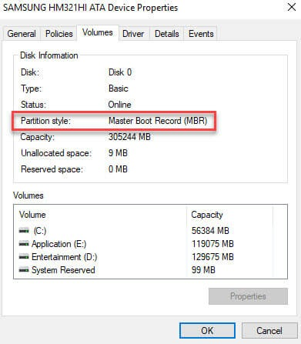
Under Image option select standard windows installation
Under Partition scheme select your Hard disk partition scheme like GPT or MBR (if you not know about your partition scheme than go to control panel<open administrative tools<select computer management<now select Disk management<on the right side right click on Disk 0 and select properties<click on volume tab and see your partition style.

Slide 19
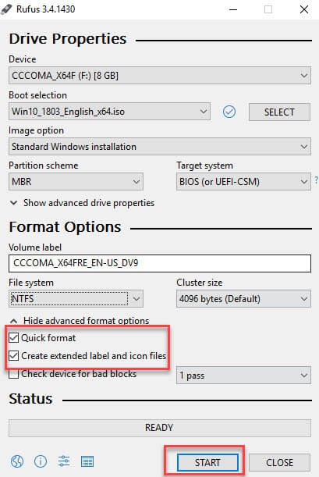
Under volume, label enter a name for your drive.
Leave Default setting under File system and Cluster size.
Now click on Advance format option and check the Quick format and create extended label and icon file.

Slide 20
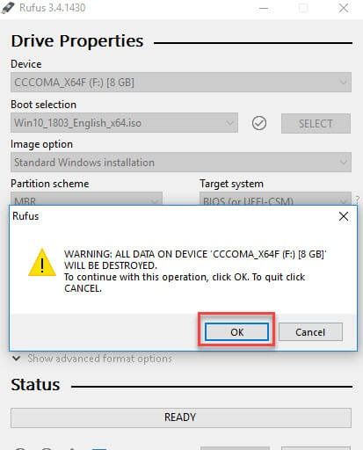
Click on start button and click OK for start formatting flash drive waits until the process complete.

Slide 21
Windows 10 Installation Process
Restart your PC in BIOS mode (there may be different ways to go in BIOS mode for different PCs) in my case I press F2 during PC start to go in BIOS and then find BOOT option where you can change the 1st boot priority to USB storage or removable media according to your PC.

Slide 22
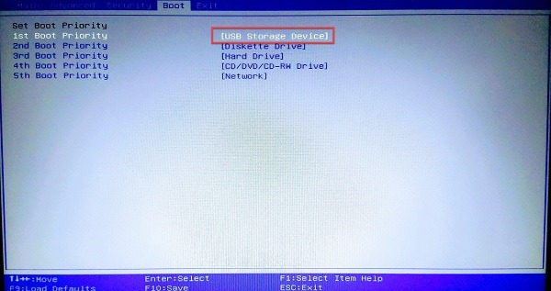
Boot Priority

Slide 23
Time and Currency and Keyboard format
Now you see the first setting of installing process is about Language, Time and Currency and Keyboard format. Change the settings according to your own and click Next.

Slide 24
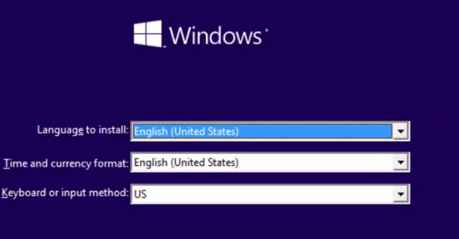
Language, Time, Keyboard

Slide 25
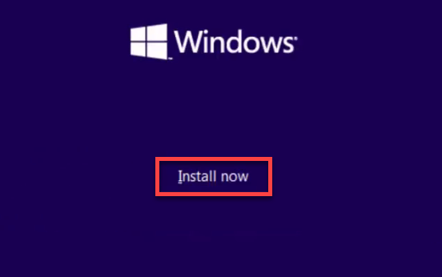
Install Now
Now click on Install Now

Slide 26
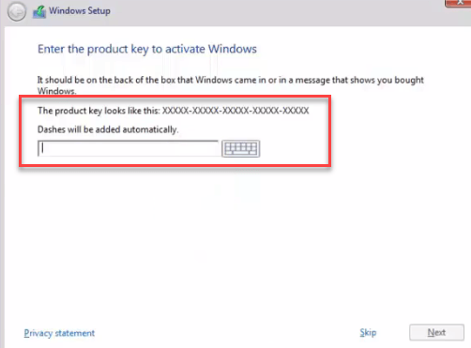
After that, it asks for license key if you purchase it then fill it there and if you have not at that moment so click on skip.

Slide 27
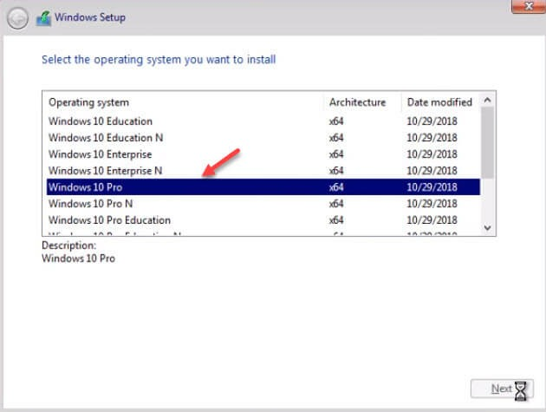
computer architecture
Then, select your computer architecture (x 64 bit or x 86 bits) according to your PC and select windows edition.

Slide 28
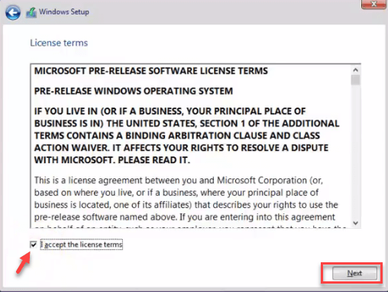
Accept the Microsoft license term and click on next.

Slide 29
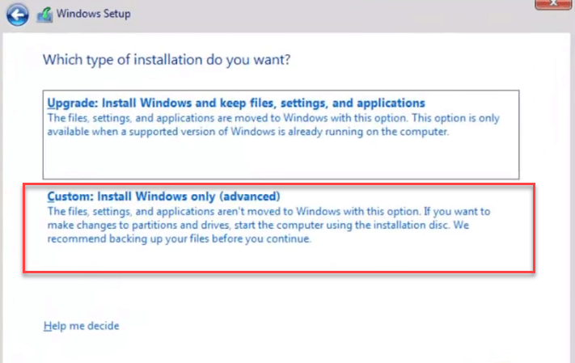
Now you have to decide “which type of installation you want” click on custom install.

Slide 30
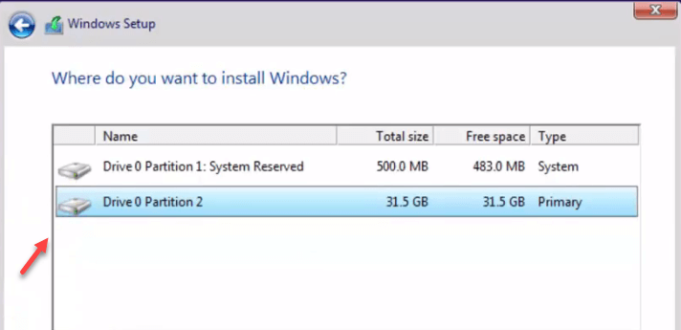
Select “where do you want to install windows”, carefully select the drive in which do not have any data or important data.
After selection of partition click on format, it will format your partition and click next

Slide 31
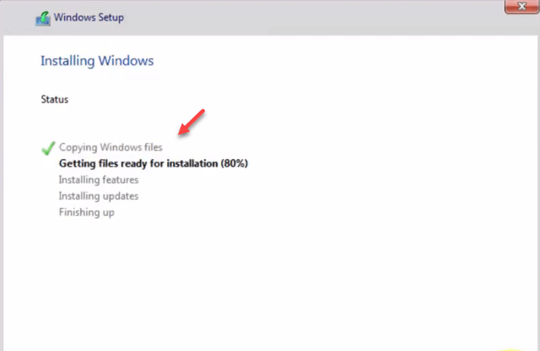
After clicking next, windows will start the installation process in your selected drive.

Slide 32
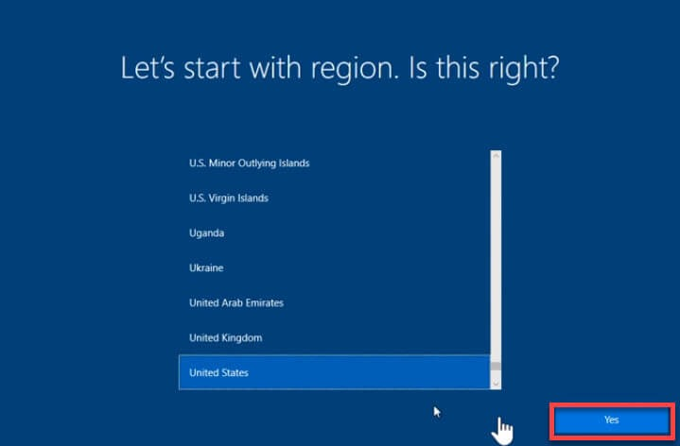
Now windows ask about your region select your region and click next

Slide 33
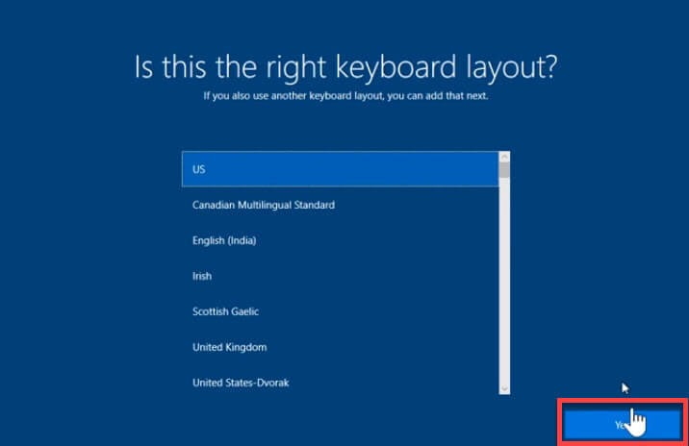
Then, select keyboard layout and click next

Slide 34
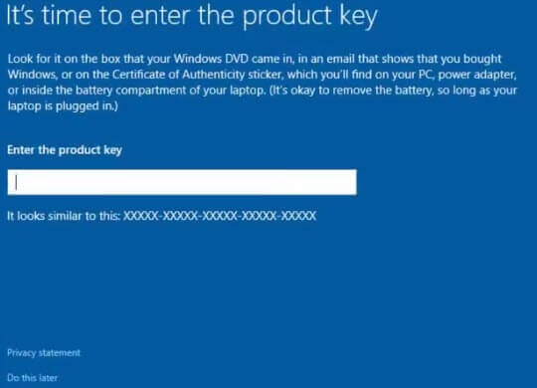
if windows ask for product key then enter it or click on below option do this later.

Slide 35
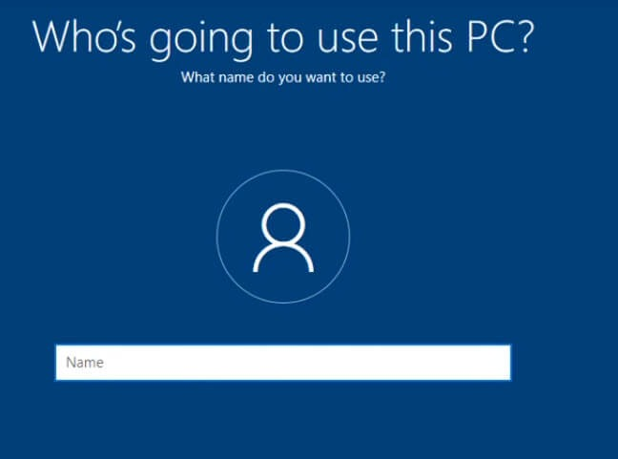
Now enter your PC name or Password and click next.

Slide 36
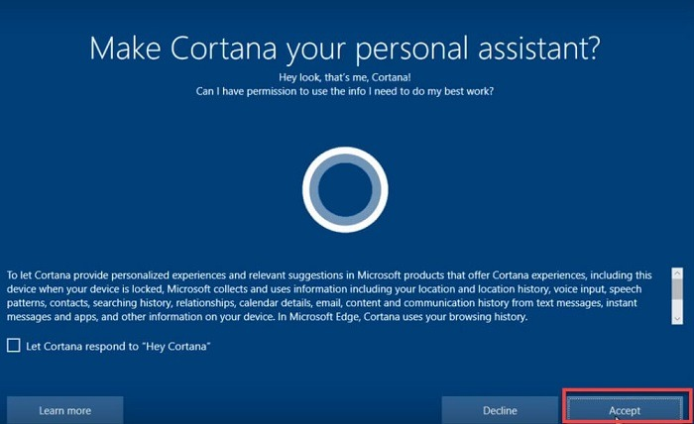
After that accept Cortana personal assistant

Slide 37
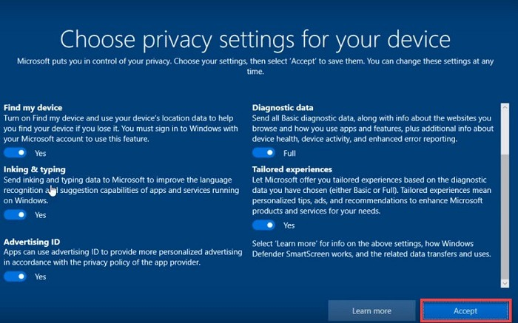
Now choose privacy setting and then click Accept

Slide 38
Then, windows take time to setup settings.
Done

Slide 39
Others Operation & Necessary Software Installation

Slide 40
Thank You

